Slide 1
Business process & CyberSecurity
Joy Gray, Ph.D., CIA, CISA – Bentley University
Jonathan Green, CISSP -- Deloitte

Slide 2
OBJECTIVE:
GOOD DATA FOR DECISION-MAKING
Information Qualities:
Confidentiality, Integrity, Availability
Compliance, Reliability, Efficiency, Effectiveness
Data and Applications
Entity-Level (ITGC)
Business Processes
Data Governance
Risks
Controls
Controls
Controls
IT Layers: Physical, Network, Operating System, Database, Application
Risks

Slide 3
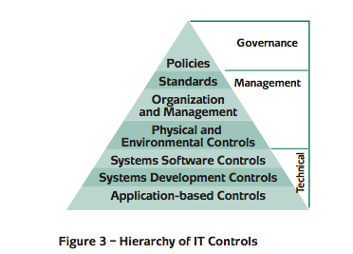
Where do cyber security controls fall in this hierarchy?
GTAG 1. The Institute of Internal Auditors.

Slide 4
Case Studies
American Superconductor
Social Engineering
GE
Steganography
Nine Unnamed Companies
SEC Release No. 84429
Norsk Hydro
Ransomware

Slide 5
Resources
Global Technology Audit Guides – The Institute of Internal Auditors
COBIT Based Audit Programs - ISACA
Merging of Cybersecurity and Operational Technology – CSX
Cybersecurity Nexus - ISACA
Internal Auditor Magazine – IIA (available in Proquest)
Federation of European Risk Management Associations – FERMA
NIST Cybersecurity Framework – NIST
Verizon Cybersecurity Report - Verizon

